Slide 1
Lift Us Up
Giving the needy exactly what they want

Slide 2
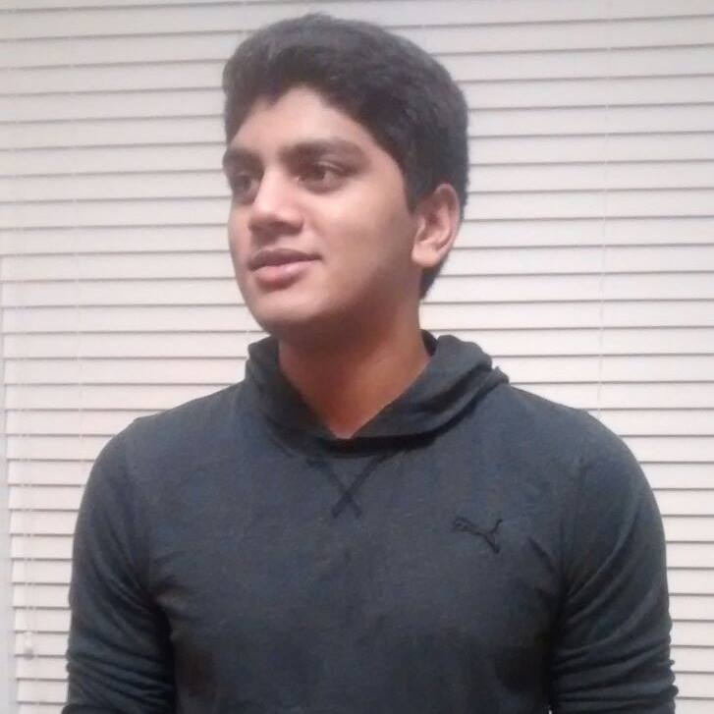
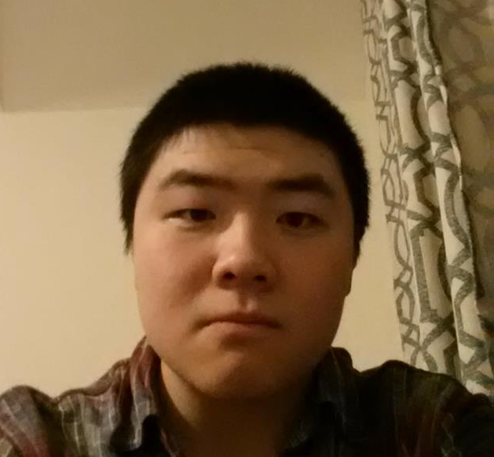
The team
SLACKERS
Bay Zhang
Abhijit Kambalapally
Somewhere attending a lecture for his part time course
Standing right in front of you
Notes:
You see why we are called that when its time for the demo

Slide 3

Mission statement:
To significantly improve the lives of really poor people by providing them the things that matter

Slide 4
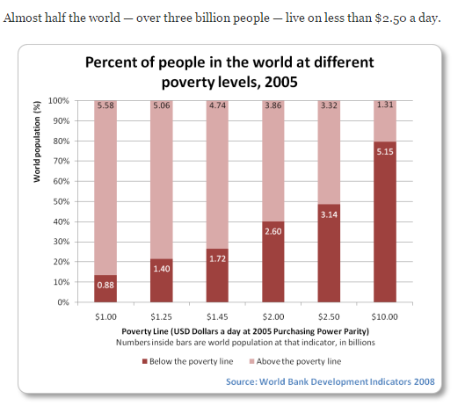
The problem
At least 80% of humanity lives on less than $10 a day
Source: http://www.globalissues.org/article/26/poverty-facts-and-stats

Slide 5
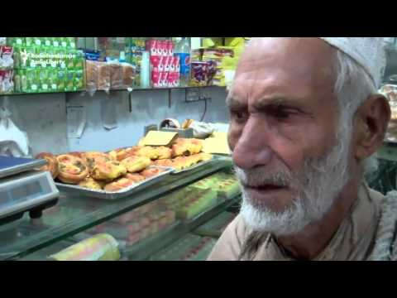
Meet
Syed Abdul Bhagi
Source: https://www.youtube.com/watch?v=lgmr7_-k-X0

Slide 6
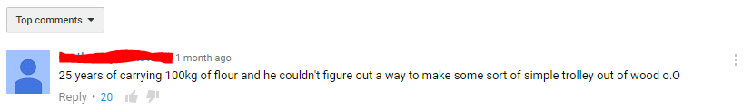
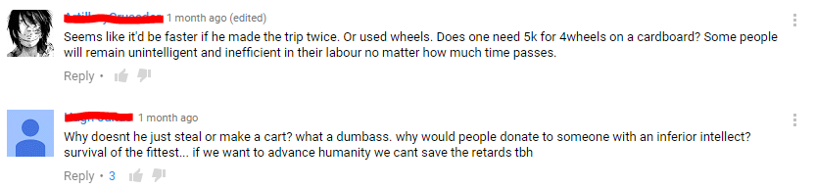
So how can you improve his life?
Let’s see what youtube says...
Notes:
Btw these are not my fake accounts

Slide 7

The solution
Online donation platform where you donate NOT MONEY but the exact ITEMS that one needs

Slide 8

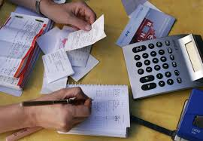

How it works
Step 3
Step 2
Step 1
Item is delivered by the third party straight to needy
Discover and pay for the item(s)
Post your story and the items that you need

Slide 9

This is the part where you significantly lower your expectations
(DEMO TIME!)

Slide 10

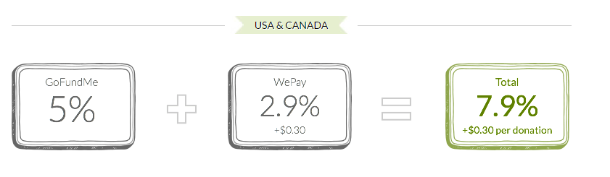

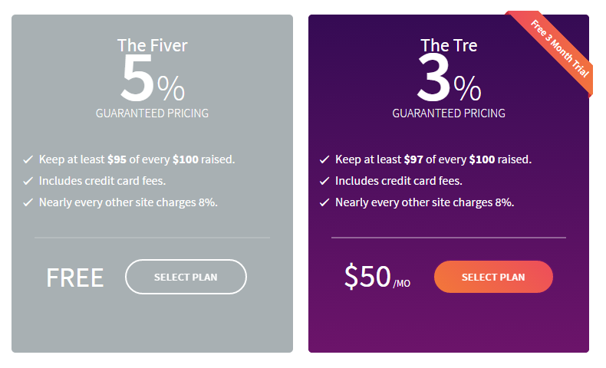

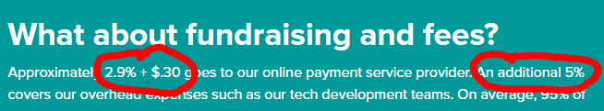
What differentiates us?

Slide 11
NO FEES!!!
Non profit
Revenue model
Donator
Needy
Server and Developer Maintenance costs
100%
100% of donors money goes towards donations.
Our revenue comes from the commission costs given by Amazon/eBay when we facilitate the sale. That money is used towards maintenance / server costs.
>4%

Slide 12
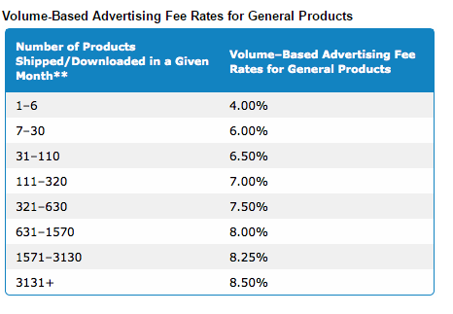

Slide 13

BIG CHALLENGE
How to reach these people?
They post their profiles here
Charity sponsored
Mail/Fax/Phone to contact us
Personal referral

Slide 14
Thank You.
WE’RE HIRING!
if you can work for free.
Designers
Developers
Test Users

Slide 15
Questions? Comments?

